Slide 1
Forecasting Gold Prices
Forecasting project
Group 5:
Mr. Ritesh Singh
Mr. Hazrath Husain
Eshan Pandey
Shaik sabreen parveen
Yashwat pandey
Veer b. singh
Husain moiz burhanpurwala

Slide 2
Business Objective:
Data provided is related to gold prices. The objective is to understand the underlying structure in your dataset and come up with a suitable forecasting model which can effectively forecast gold prices for next 30 days.
This forecast model will be used by gold exporting and gold importing companies to understand the metal price movements and accordingly set their revenue expectations.

Slide 3
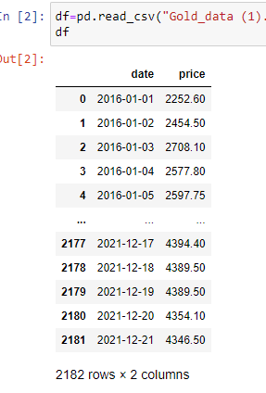
Understanding dataset:
We can see that data set has two columns date and price (Gold prices)
There are 2182 rows and 2 columns

Slide 4
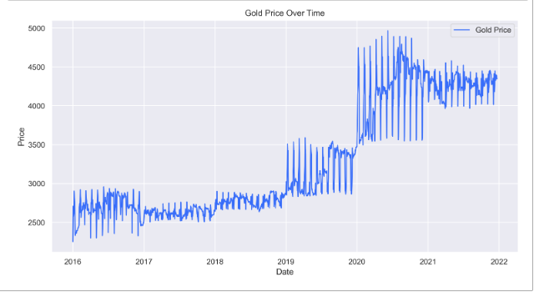
Graph plot of Gold prices over time:
We can understand one thing from this graph is gold prices have increased over time

Slide 5
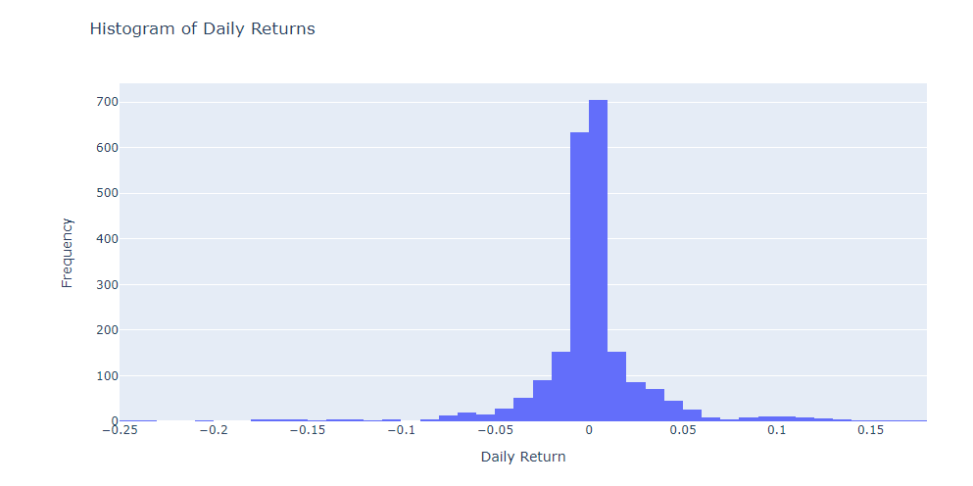
Histogram of Daily Returns:
Tall peak in the middle shows that avg daily gold price are increasing by 0 to 0.01%. This means most of the time daily gold price does not change significantly
The distribution appears to be roughly symmetrical. This suggests that positive and negative daily returns occur with similar frequencies.
histogram shows that while most returns are close to zero, there are some days with larger positive or negative returns, but these are less frequent The spread of the.

Slide 6
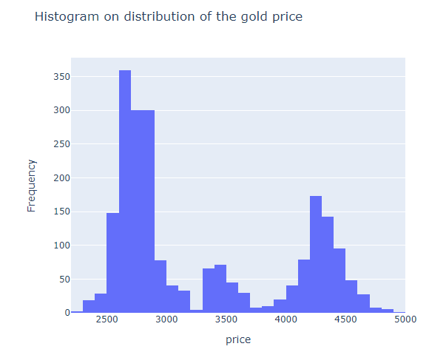
Histogram on distribution of the gold prices:
Gold price spread from 2200rs to 5000rs
Peaked at 2600 to 2700rs

Slide 7
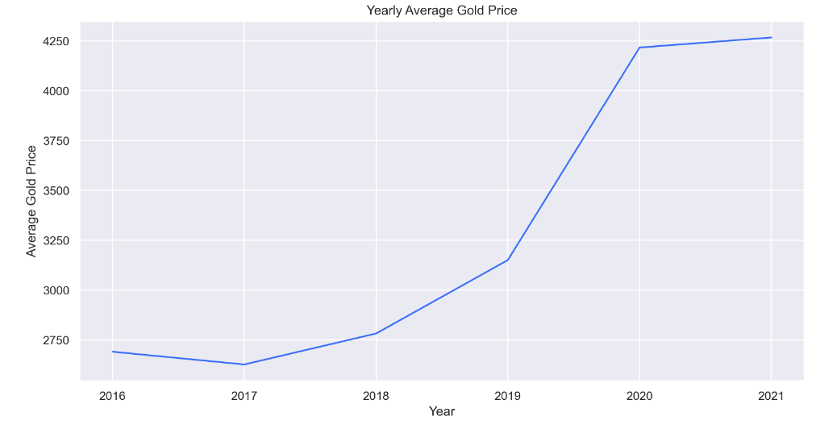
Yearly Average Gold Price:
From 2019 to 2020 gold prices shot up really fast 3150rs to 4150rs

Slide 8
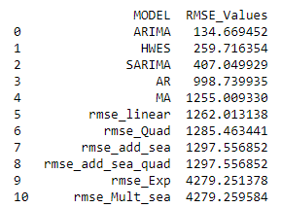
Model we build and RMSE values for theme:
We can see there are 11 models we tried.
From model evaluation we can see RMSE value for ARIMA model is lowest.
So we selected ARIMA model for deployment

Slide 9
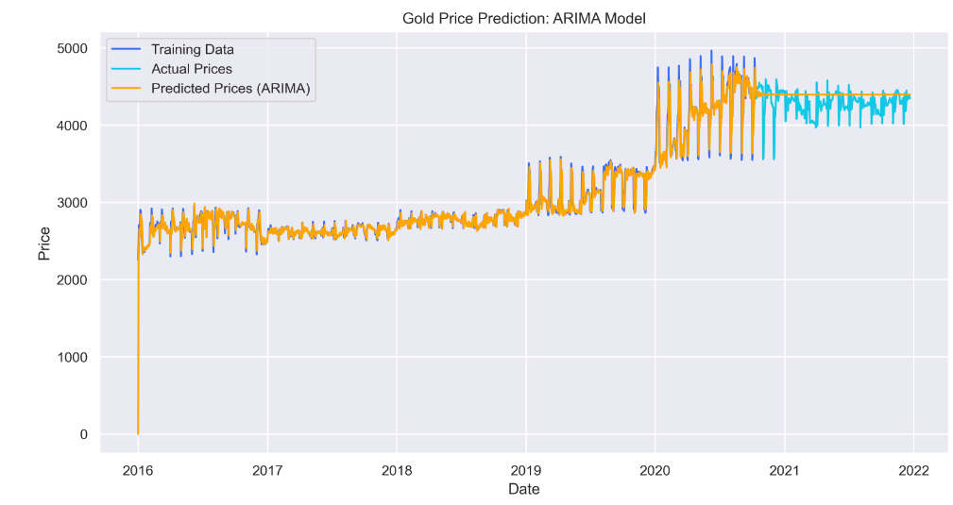
Gold prices test prediction and comparison of ARIMA model:
Yellow line is predicted prices and Dark blue is training data with the prediction line we can see error are really less.

Slide 10
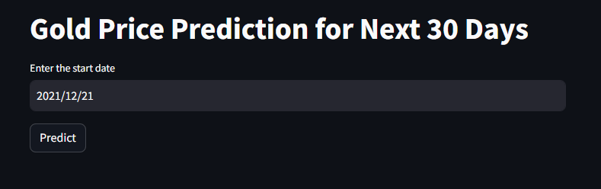
Deployment template :
This will predict the next 30 days of gold prices from 21/12/2021 date onwards.

Slide 11
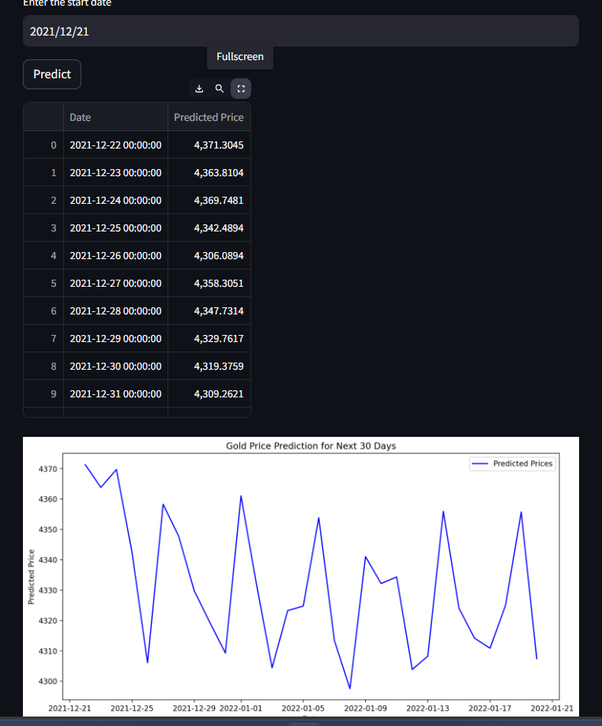
After deployment:
We can see the predicted values starting from 21-12-22 to next 30 days when you press on the Fullscreen button
We can also a graph gold prices are going to fluctuate a lot for next 30 days

Slide 12
Thank You

